Slide 1
WHR in HVAC system
Description of idea:
Waste heat recovery system based on components already available within the HVAC system on light vehicles. All system components would need some degree of redesign to allow for use as both a cooling and energy generating system.

Slide 2
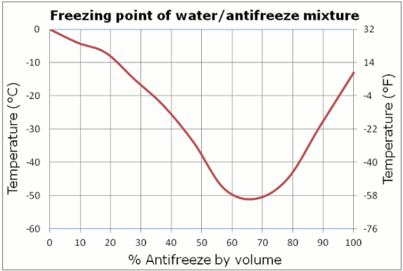
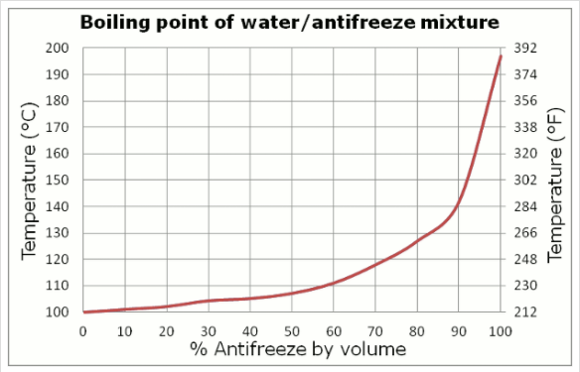
Technical obstacles
Variability of phase transition points in the cooling system of vehicles
In order to influence the temperature at which an engine is protected from the cold, or conversely to protect from overheating in warmer climates, the mixture of glycol and water in the cooling system is varied by manufacturers as well as end users. This leads to an unreliable phase transition temperature which is critical for a functioning Rankine cycle.

Slide 3
Technical obstacles
Low grade heat
Low grade heat is defined by most publications as any temperature difference less than 450ºF (232ºC). Most internal combustion engines under normal operation do not produce temperatures this far above the average ambient temperature.

Slide 4
Technical obstacles
Cooling load
Harvesting waste heat from the exhaust stream was also considered as this offers a potential for higher grade heat. The problem with this has several facets. The first is that the power generating system proposed would have to reject some 20% of the heat used to effect a phase transition. Because this heat was previously to be rejected to atmosphere in the exhaust stream, the conventional cooling system would be under additional load. Additionally, the highest quality heat would need to be harvested from the exhaust stream ahead of the catalytic converter which raises packaging, performance and chemical reaction problems that would need to be solved in addition to the WHR solution.
This seems like a bad direction to pursue considering the fact that harvesting waste heat from the cooling system would serve to reduce the cooling load rather than increase it. A secondary benefit to the increased efficiency.
Notes:
Harness heat from cooling loop as a pre-heat and then from the exhaust.
Evs probably have an air-conditioning system that could be used to pump waste heat into the cabin in the winter.

Slide 5
Technical obstacles
Working fluid limitations
If the solution were to take advantage of the existing HVAC architecture, the working fluid (water/glycol) would have an inappropriately high phase transition temperature. Additionally, if the working fluid were compressed in order to reduce the boiling temperature, the possibility of steam in the existing cooling system would have to be dealt with.
Notes:
Dual vane compressor. - Nate

Slide 6
Solutions
Use a closed circuit with a different working fluid
This prevents complicating the existing cooling loop with undesirable phase changes or compromising the vapor power cycle when the glycol/water ratio is changed.
Using R245fa or similar also reduces the necessary temperature of the waste heat source.

Slide 7
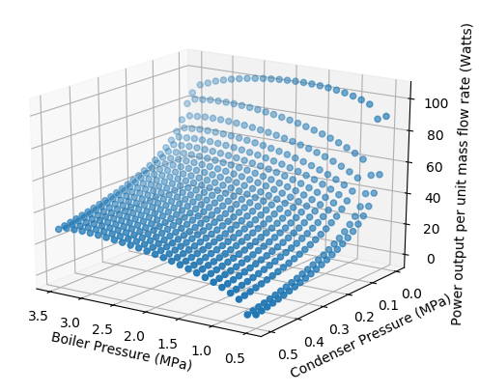
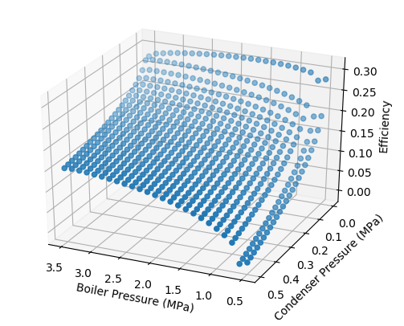
Solutions
Using R245fa moves the working pressures and temperatures of the boiler and condenser into ranges that are plausible for an automotive application.

Slide 8
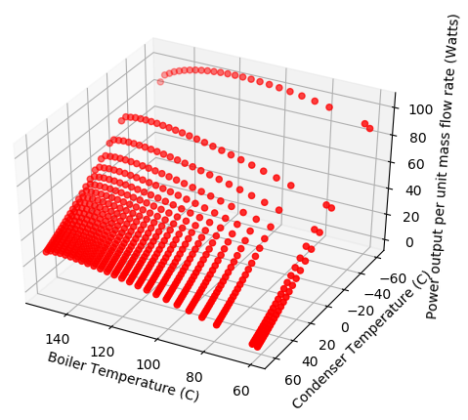
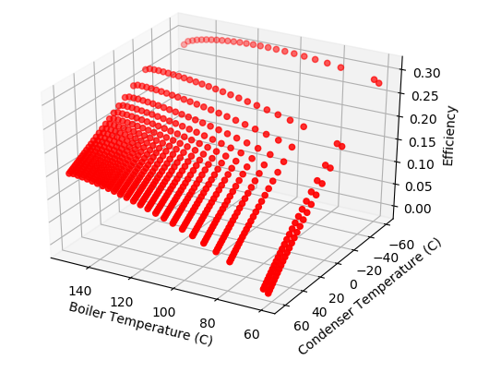
Solutions
Using R245fa moves the working pressures and temperatures of the boiler and condenser into ranges that are plausible for an automotive application.

Slide 9
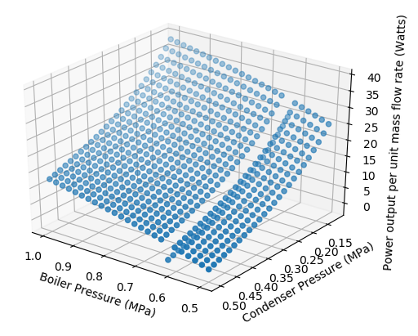
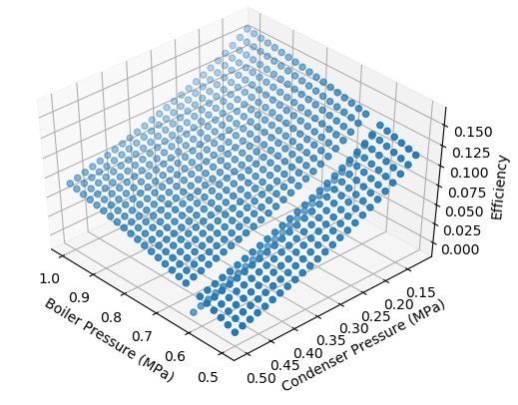
Solutions
The solution was re-run in the temperature and pressure ranges that are reasonable for this specific application.

Slide 10
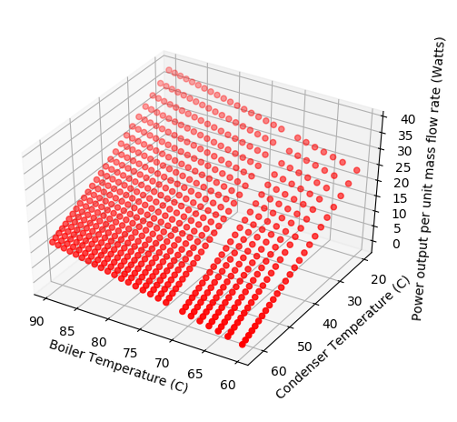
Solutions
The solution was re-run in the temperature and pressure ranges that are reasonable for this specific application.

Slide 11
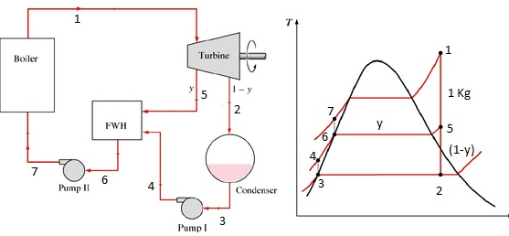
Efficiency improvements
Regenerators

Slide 12
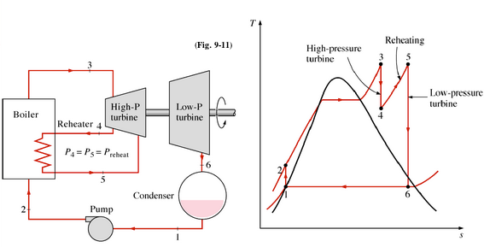
Efficiency improvements
Reheaters

Slide 13
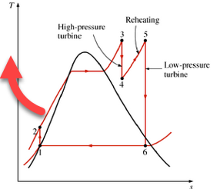
Efficiency improvements
Super heated vapor

Slide 14
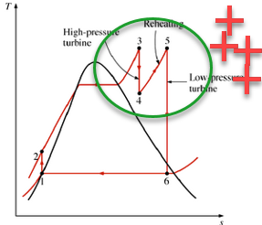
Efficiency improvements
Multi-stage turbine
Notes:
Replace the pump with solenoid valves that prevent adding back pressure to the condenser.

Slide 15
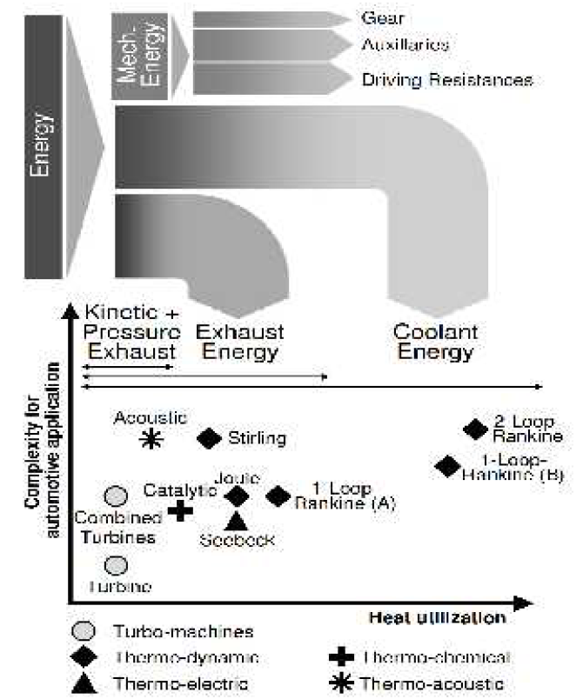
Complexity vs. Heat Utilization

Slide 16
More plausible applications
Diesel locomotive
Commercial trucking (Heavy duty vehicle)
Paper Milling
Brewing/Distilling
Heavy duty vehicles
Aerospace
Residential - Cogeneration
Notes:
Develop and assist with integration, but OEM would have to be responsible for designing the system into the vehicle.
Developing components should be done with dedicated software package.
IP search
Which OEMs and/or Tier 1s are working on this now?

